Slide 1
Olist E-Commerce Analysis
Presented By : Yogesh Kumar Chaurasiya
DATA ANALYSIS

Slide 2
Agenda
Objectives
Appendix
Visualizations
Dashboard
Recommendation
Conclusion
Data Sources
Data Methodology

Slide 3
Objectives
Our main objectives for this project are as follows :
Identify the top products contributing to revenue and the leading product category.
Enhance our understanding of customer purchase behavior through market basket analysis.
Determine which items are most likely to be purchased individually or in combination with other products

Slide 4
Appendix – Data sources
Here's an overview of our data dictionary, which includes key information categories:
1.Order Details: This category encompasses data elements like order ID, order status, order purchase timestamp, and more.
2. Order Items Details: Within this category, you'll find information such as order item ID, seller ID, item price, shipping charges, and related details.
3. Customer Details: This section includes data related to customers, including customer ID, customer city, customer state, and other pertinent information.
4. Payment Details: Here, you'll find data pertaining to payment transactions, including payment type, payment value, and other relevant payment-related details.
5. Product Details: This category covers product-specific data, such as product ID. product category name, product dimensions, and related information.
We sourced our data from the Olist retail dataset, which provides comprehensive information related to orders. This dataset covers the period from 2016 to 2018, allowing us to conduct a thorough analysis of historical data and draw meaningful insights.

Slide 5
Appendix – Data Methodology
Our data analysis process included:
1. Cleaning and transforming the dataset in particular software.
2. Replacing missing values with suitable alternatives.
3. Removing redundant and duplicate records, retaining only the first occurrence.
4. Performing various visualizations and Market Basket Analysis in Tableau

Slide 6


Visualizations
KPI cards :
The KPI card displays the total customer count, which stands at 99k. This metric quantifies the size of the customer base, a fundamental aspect of understanding a business's reach and potential market.
The KPI card presents the average delivery time, indicating orders are typically delivered in 13 days. A lower number signifies efficient shipping processes, enhancing customer satisfaction and trust.
The KPI card conveys an average review score of 4. This reflects the overall customer satisfaction with products and services, with a higher score indicating positive feedback and quality.

Slide 7
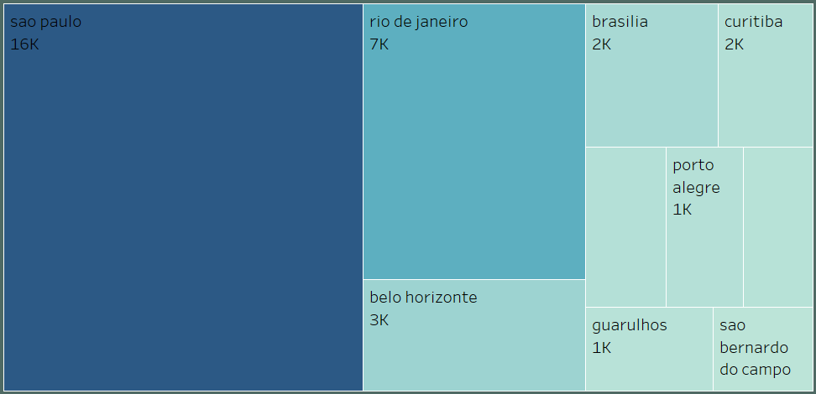
Visualizations
Top 10 Cities By Customer :
Sao Paulo emerges as the top-performing city with 16k in sales, followed by Rio de Janeiro at 7k, while Belo Horizonte and Brasília both contribute 3k, underscoring the regional significance of these customers in the top 10.

Slide 8
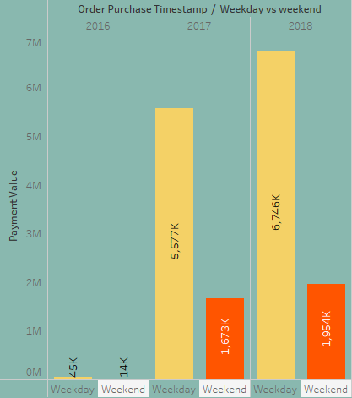
Visualizations
Weekday Vs Weekend Payment Stats :
The bar chart illustrates the stark contrast between weekday and weekend sales over a three-year period. In 2016, weekday sales stood at 45k, while weekend sales were at 14k. Fast forward to 2018, and we observe a substantial increase, with weekday sales at 6,746k and weekend sales at 1,954k. This progression highlights the significant growth in weekday sales compared to weekends, suggesting a potential shift in consumer behavior or sales strategies.

Slide 9
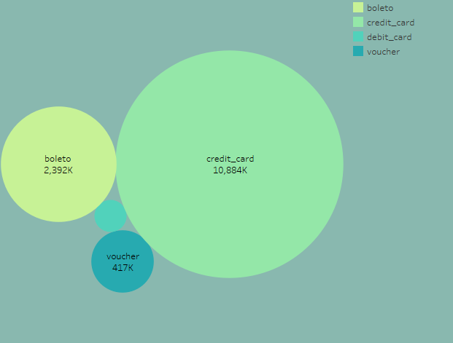
Visualizations
Count Of Orders By Payment Type :
In the packed bubble chart, we illustrate the distribution of total orders by payment type. Credit card transactions take the lead with 10,884k orders, followed by Boleto has 2,392k , voucher has 417k, and debit card has 184k, showcasing the prominence of credit card payments in this dataset.

Slide 10
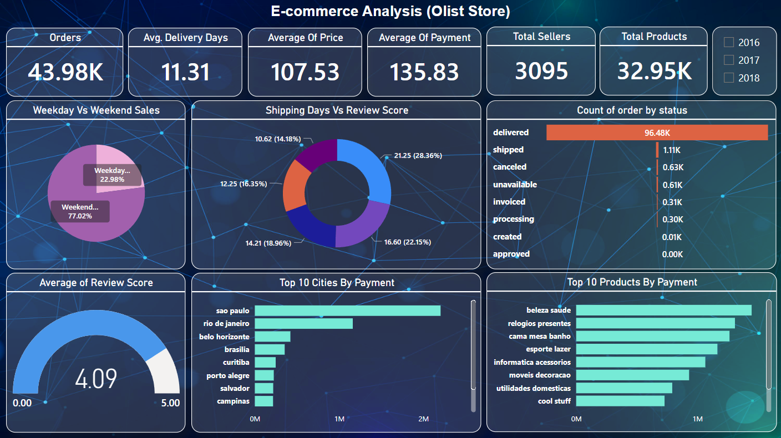
Dashboard

Slide 11
Recommendation
Based on our findings, we recommend the following strategies :-
Allocate more resources to credit card payment processing, as it constitutes the highest share of total orders at 10,884,000 (10,884k).
Focus on increasing voucher payment adoption due to its significant presence in total orders at 417,000 (417k).
Optimize marketing strategies for weekday sales, particularly in 2018, which generated 6,746,000 (6,746k) in revenue.
Strengthen the customer base in São Paulo, as it represents the largest revenue contribution among the top 10 cities at 16,000.
To meet customer demands, they must stock a vast array of products in their warehouses, which adds to their operational costs.

Slide 12
Conclusion
In conclusion, the Olist dataset provides essential business insights. It highlights a predominant use of credit cards for payments, suggesting a need for diversification. The data showcases consistent growth in weekday sales, indicating the potential for increased revenue during the workweek. Sao Paulo emerges as a critical market, commanding a substantial customer base. To maximize opportunities, strategies should focus on expanding payment methods and tailoring marketing efforts in key cities while capitalizing on the weekday sales trend.

Slide 13
THANK You

